Slide 1
The Brain

Slide 2
Neuroimaging Techniques
PET – Positron Emission Tomography
depicts brain activity by showing the consumption of radioactive glucose – area lights up
MRI – Magnetic Resonance Imaging
the head is put in a strong magnetic field, which aligns the spinning protons of brain molecules. Then a radio wave pulse momentarily disorients the protons. When the protons return to their normal spin, they release signals that provide a detailed pictures of the brain’s soft tissue.
fMRI – comparing MRI scans taken less than a second apart.

Slide 3
CT (roentgen-ray computed tomography) A beam of x-rays is shot straight through the brain. As it comes out the other side, the beam is blunted slightly because it has hit dense living tissues on the way through. Blunting or "attenuation" of the x-ray comes from the density of the tissue encountered along the way. Very dense tissue like bone blocks lots of x-rays; grey matter blocks some and fluid even less. X-ray detectors positioned around the circumference of the scanner collect attenuation readings from multiple angles. A computerized algorithm reconstructs an image of each slice. (example)
MRI (magnetic resonance imaging) When protons (here brain protons) are placed in a magnetic field, they become capable of receiving and then transmitting electromagnetic energy. The strength of the transmitted energy is proportional to the number of protons in the tissue. Signal strength is modified by properties of each proton's microenvironment, such as its mobility and the local homogeneity of the magnetic field. MR signal can be "weighted" to accentuate some properties and not others. When an additional magnetic field is superimposed, one which is carefully varied in strength at different points in space, each point in space has a unique radio frequency at which the signal is received and transmitted. This makes constructing an image possible. It represents the spatial encoding of frequency, just like a piano. (example). More details of MR here.
SPECT/PET (single photon/positron emission computed tomography) When radiolabeled compounds are injected in tracer amounts, their photon emissions can be detected much like x-rays in CT. The images made represent the accumulation of the labeled compound. The compound may reflect, for example, blood flow, oxygen or glucose metabolism, or dopamine transporter concentration. Often these images are shown with a color scale. (example) Next
Contributed by Sam Patz, Ph.D. http://www.med.harvard.edu/AANLIB/sigsors.html

Slide 4
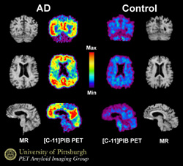
The left two columns are of a brain with Alzheimer’s disease. The right two columns show a brain without Alzheimer’s disease. PET scans are flanked by MRI scans. The color gradient reflects levels of amyloid density.
Notes:
William E. Klunk (left) and Chester A. MathisKlunk and Mathis have developed experimental noninvasive methods of detecting and creating images of amyloid-beta proteins (plaques that form in the brain tissue of Alzheimer’s sufferers) using dyes to make the plaques visible through the use of medical imaging equipment. The ability to see amyloid deposits in living patients will enable researchers to directly measure the effects of anti-amyloid therapies now being developed.

Slide 5
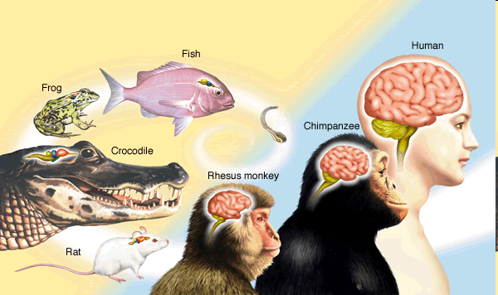
Evolution of the brain

Slide 6
The Cerebral Cortex
Forebrain
Neurons and Glial cells
Frontal Lobe
Parietal Lobe
Temporal Lobe
Occipital Lobe
Notes:
Glial cells provide nutrients and insulating myelin
Separated by prominent fissures

Slide 7
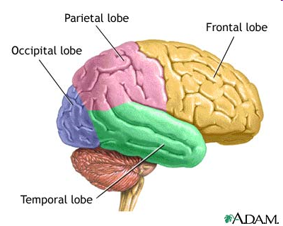

Slide 8
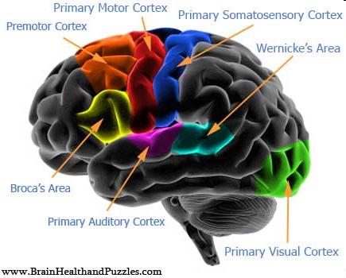

Slide 9
Frontal Lobe
speaking, muscle movements, planning and making judgements
motor cortex – controls movements of body parts
fingers and mouth – more cortical space
Neural Prosthetics

Slide 10
Parietal Lobe – sensory cortex – receives input from the skin senses & movement of body parts
sensitive body parts are represented more
Temporal Lobe – auditory cortex
Occipital Lobe – visual cortex
crossover
Notes:
MRI scans of schizophrenic actives reveal active auditory areas in the temporal lobe during auditory hallucinations

Slide 11
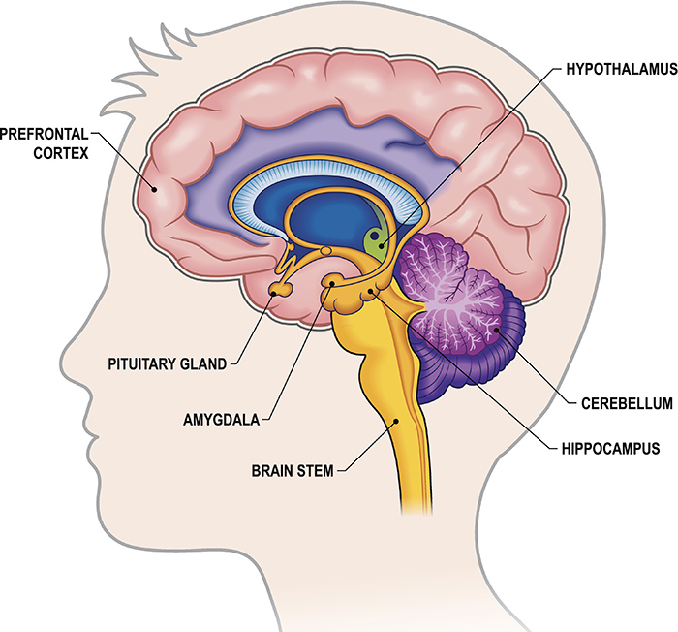
Mid Brain

Slide 12
The Limbic System
Hypothalamus
Amygdala
Pituitary Gland
Hippocampus

Slide 13
Hypothalamus: below thalamus
Hunger, thirst, body temperature, sexual behavior
Pleasure center – Experiment by Olds & Milner (1954)
Talwar & colleagues (2000)
Notes:
By stimulating the pleasure center thru electrodes – trained caged rats to navigate natural environments. By pressing buttons on a laptop the researchers can direct a rat to turn on cue, climb trees, scurry along branches, turn around and come back down. Carrying a receiver and video camera. Search & rescue operations

Slide 14
Amygdala: seat of emotion
1939 – lesioned a monkey’s brain
Aggression, Fear
Hippocampus: explicit memory
Pituitary Gland: Master Gland controls endocrine system

Slide 15
Hind Brain
The Brainstem: central core
Medulla - heartbeat & breathing
Pons – co-ordinate movements
Crossover Point – where nerves to and from each side of the brain connect with the opposite side of the body

Slide 16
The Thalamus: top of the brainstem –
brain’s sensory switchboard
receives information sends it to higher brain regions
gets replies and sends it to the medulla and cerebellum

Slide 17
The Cerebellum:
Co-ordinates voluntary movements
Memory, discriminate sounds and textures, judge time
Notes:
Sense of balance – walking, shaking hands – co-ordination - sporstpeople

Slide 18
Neurotransmitters
Acetylcholine muscle action learning memory
Dopamine movement learning emotion
Serotonin mood hunger sleep arousal
Norepinephrine alertness arousal
GABA inhibitory role
Glutamate excitatory role

Slide 19
Brain’s Plasticity
Hemispherectomies – opposite limb movements are compromised
Deaf
Blind
Notes:
enhanced peripheral vision- deaf – temporal lobe takes on visual processing
Blind – occipital lobe – takes on touch for braille

Slide 20
Corpus Callosum: wide band of axon fibres connecting two hemispheres
Severing it
Experiment by Gazzaniga (1967)
Notes:
HE*ART
What word did you see – ART
Point with your left hand to what you saw – HE
Simultaneously draw two different shapes with two hands

Slide 21
HE*ART

Slide 22
When asked what they had seen – they said Art
When asked to point out what they had seen – their left hand pointed to He

Slide 23
Left hemisphere – language processing
Right hemisphere – perceptual tasks, inferences

